Slide 1
Pipetting
Transfer Pipet Video
Micropipet Video

Slide 2
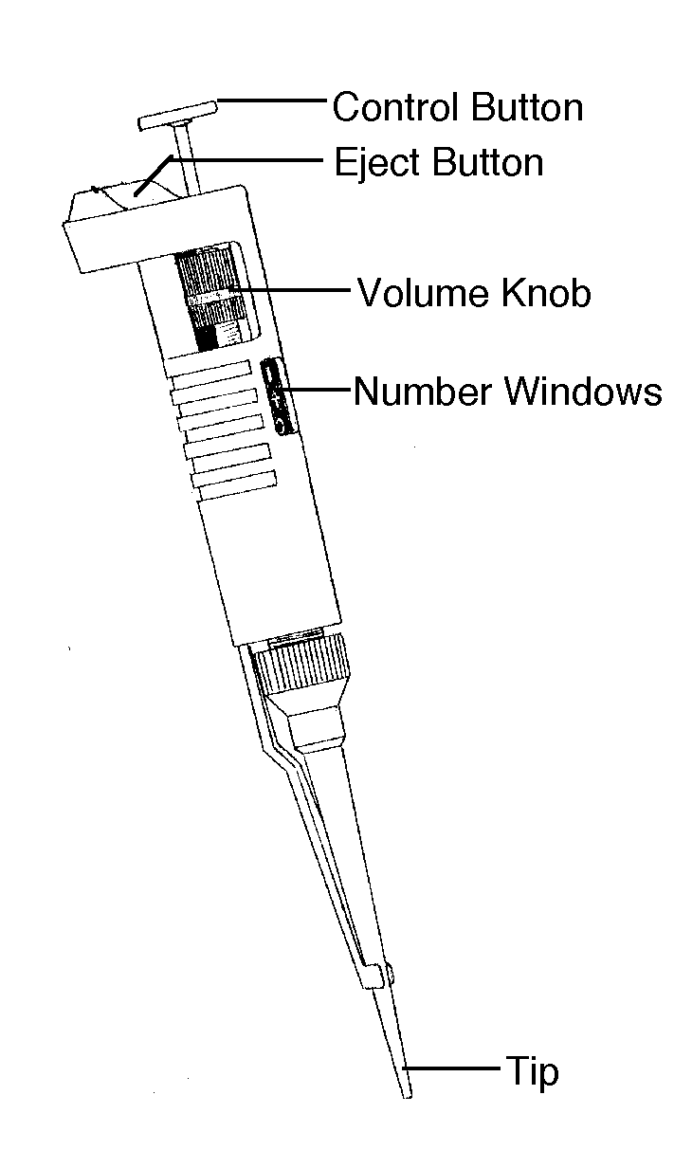
Have you seen a pipettor before?
Courtesy Cornell Institute for Biology Teachers
https://blogs.cornell.edu/cibt/labs-activities/
Notes:
Go over the parts of the pipettor as you point them out in the real pipettor in your hand

Slide 3
Look at the top of your pipettor:
2
>
This is the range that your pipettor can handle.
What is the unit?
20
Microliter (µl)
> microliters
1
5
0
Decimal point

Slide 4
Practice!
1. Set your pipettor to:
0
7
0
How much is this?
7 µl
2. Now push the control button and find
the first stop.
3. Keep pushing and find the second stop.
Become familiar with these stops!

Slide 5
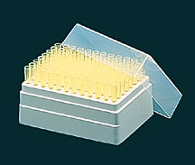
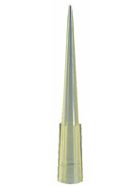
How to insert a pipette tip
Open the pipette tip box
Insert the pipettor into the tip, and push
Take the pipette and tip out of the box and secure with your fingers by pushing it backwards. Do not touch the front end of the tip!

Slide 6
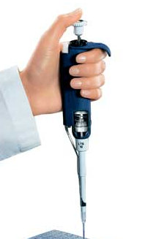
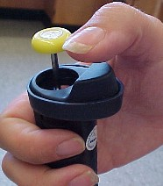
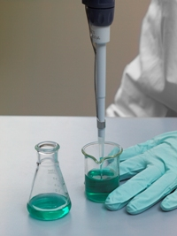
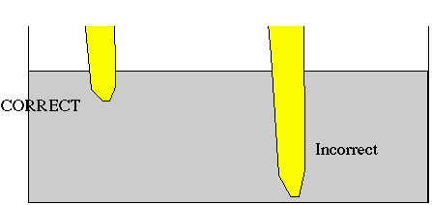
Pipettor use and safety guidelines:
Notes:
Explain that the tip should always face downwards, never upwards or sideways
Where the eject button is and what it does
That solution should be taken from the middle of the container
4. That it is better to lift your tube and look at the side of the tube when you are pipetting, to make sure you are uptaking the solution, instead of letting it sit on the top of the table while you pipette.

Slide 7
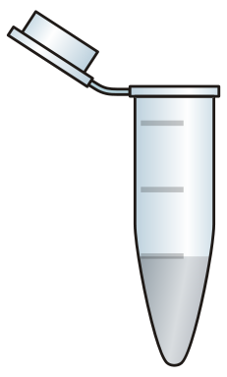
Pipettor Demo!
Teacher transfers 200 µl of green colored water to another tube.
- Always hold tube at eye level
- Push control button to first stop and hold
- Submerge tip in the solution and let go of control button (you are sucking up the solution)
- Transfer to second tube: go to side wall of the second tube with the pipette tip and push control button to the first stop; hold for a second, then push all the way to the second stop
- Holding down the control button, take out the pipettor. If you don’t hold the control button down before you take the pipettor out you will suck up some of the solution again
More Practice

Slide 9
GEL ELECTROPHORESIS
Casting an agarose gel video
Agarose Gel Electrophoresis video
Gel Electrophoresis Virtual Lab

Slide 10
Gel Electrophoresis - Steps
DNA fragments
Agarose gel fibers
Cut DNA
Make gel
Run DNA in the gel
Courtesy Cornell Institute for Biology Teachers
https://blogs.cornell.edu/cibt/labs-activities/
Notes:
Make more of a mesh maybe even do finer lines, change shapes of DNA into lines.

Slide 11
Gel Electrophoresis
DNA fragments
Why does the DNA move?
How do we know how far the DNA has run?
When do you stop running the gel?
Why do differently sized fragments of DNA move at different speeds?
Notes:
Make more of a mesh maybe even do finer lines, change shapes of DNA into lines.

Slide 12
Gel Electrophoresis
DNA fragments
Agarose gel fibers
-
-
-
-
-
+
+
+
The DNA is negatively charged by nature, and it moves because it is attracted to the positive end of the gel box.
To make sure the DNA doesn’t run off the gel we use a loading (or indicator) dye. The dye is a small molecule, much faster than any of the DNA fragments and is visible to the naked eye. Because it runs faster than the DNA fragments, we can be sure that once it reaches the end of the gel, the DNA fragments are still in the gel.
When the loading dye reaches the end of the gel, we know the DNA is close to the edge as well.
The smaller fragments of DNA move faster than the heavier, larger fragments because is easier for them to go through the maze of agarose fibers.
Notes:
Make more of a mesh maybe even do finer lines, change shapes of DNA into lines.

Slide 13
Alternative DNA Fingerprinting Scenarios
1. Food identification (endangered species identification).
The purity (or impurity) of ground beef has been proven using DNA typing. Hamburger has been shown to often be a mixture of pork and other non-beef meats. Using portable testing equipment, authorities have used DNA typing to determine that the fish served in sushi was really meat from whales and dolphins. These are, many times, endangered species that are protected by international law.
2. Accused and convicted felons set free because of DNA typing.
A man imprisoned for 10 years was released when DNA testing, unavailable when he was convicted, was used to show that he could not have been the rapist. Statistics show that about 1/3 of all sexual assault suspects are freed as a result of DNA testing.
https://www.youtube.com/watch?v=IwRqe-1pVNI
3. Identifying human remains.
Scientists have used DNA typing to confirm that the body in the grave was (or was not) the person that was supposed to be there. Bones found in Russia are believed to be those of the Romanovs, Russia’s last imperial family. Czar Nicholas II and his family were executed by the Bolsheviks in 1918. Experts from around the world have been studying the bones to match skulls, teeth, and other features with photographs. DNA from the bones was compared to that of known descendants and it was determined that the bones do belong to the czar and his family (“Identification of the remains of the Romanov family by DNA analysis” Nature Genetics vol 6, 130, 1994.)
4. Determining relatedness of humans.
DNA typing has shown that the 5,000 year old “Iceman” found in a melting glacier is most closely related to modern Europeans. ("Iceman Gets Real." Science, vol.
264:1669. June 17, 1994.) The DNA typing evidence also “removes all the suspicions that the body was a fraud—that it had been placed on the ice,” says Svante Paabo of the University of Munich. (Science, vol. 264:1775. June 17, 1994).

Slide 14
5. Studying relatedness among ancient peoples.
DNA found at archeological sites in western Montana is being used to help determine how many related groups of people (families) lived at a particular site. (Morell, Virginia. "Pulling Hair from the Ground." Science, vol. 265:741-745 August 1994.)
6. DNA testing of families.
DNA testing of families has been used in Argentina and El Salvador to identify the children of at least 9,000 citizens of these countries who disappeared between 1975 and 1983, abducted by special units of the ruling military and police. Many of the children born to the disappeared adults were kidnapped and adopted by military "parents" who claimed to be their biological parents. After genetic testing of the extended family revealed the true identity of a child, the child was placed in the home of its biological relatives. It was feared that transferring a child from its military "parents" who were kidnappers, but who had reared the child for years, would be agonizing. In practice, the transferred children became integrated into their biological families with minimal trauma.
7. Identifying organisms that cause disease.
Eva Harris, a UCSF scientist, has helped scientists in Nicaragua and Ecuador to learn to use DNA technology to detect tuberculosis, and identify the dengue virus and various strains of Leishmania. Other available tests cause waits of many weeks while disease organisms are cultured and sent to foreign labs to be identified. (Marcia Barinaga, "A Personal Technology Transfer Effort in DNA Diagnostics." Science, vol. 266:1317–1318. Nov. 25, 1994.)
8. Identifying birth parents (paternity testing).
Girls in Florida were discovered to have been switched at birth when one girl died of a hereditary disease. The disease was not in her family, but was known to be in the family of another girl, born in the same hospital and about the same time she was born.

Slide 15
9. Proving paternity.
A woman, raped by her employer on Jan. 7, 1943, her 18th birthday, became pregnant. The child knew who her father was, but as long as he lived, he refused to admit being her father. After the man died, DNA testing proved that she was his daughter and she was granted a half of his estate. ("A Child of Rape Wins Award from Estate of Her Father." New York Times, July 10, 1994.)
10. Determining effectiveness of bone marrow transplants.
"DNA fingerprinting can help doctors to monitor bone marrow transplants. Leukemia is a cancer of the bone marrow and the diseased marrow must be removed. The bone marrow makes new blood cells, so the leukemia sufferer will die without a transplant of healthy marrow. Doctors can quickly tell whether the transplant has succeeded by DNA typing of the patient and the donor. If the transplant has worked, a fingerprint from the patient’s blood shows the donor’s bands. But if the cancerous bone marrow has not been properly destroyed, then the cancerous cells multiply rapidly and the patient’s own bands predominate." ("Our Ultimate Identity Card in Sickness and in Health," in "Inside Science", New Scientist, Nov. 16, 1991.)
11. Proving relatedness of immigrants.
DNA fingerprinting has been used as proof of paternity for immigration purposes. In 1986, Britain’s Home Office received 12,000 immigration applications from the wives and children of Bangladeshi and Pakistani men residing in the United Kingdom. The burden of proof is on the applicant, but establishing the family identity can be difficult because of sketchy documentary evidence. Blood tests can also be inconclusive, but DNA fingerprinting results are accepted as proof of paternity by the Home Office. (DNA fingerprints, source unknown: Based on A. J. Jeffreys et al., "Positive Identification of an Immigration Test-Case Using Human DNA Fingerprints." Nature, vol. 317:818–819, 1985.)

Slide 16
12. Confirming relatedness among animals.
Scientists who extracted DNA from the hair of chimpanzees throughout Africa now have evidence that there might be a third species of chimpanzee. At the same time they have learned things about chimp behavior and kinship patterns that would have once taken years to theorize. They discovered a group of chimps living in western Africa to be genetically distinct from the chimps living in other parts of Africa, suggesting that the group may be an endangered species. The have discovered that male chimps living in a given area are often as closely related as half-brothers, and many so-called sub-species may all be part of a single species. The male chimps’ relatedness may explain why, unlike other primates, the males are quite friendly to each other.
13. DNA testing of plant material puts murderer at the scene.
Two small seed pods caught in the bed of his pick-up truck put an accused murderer at the murder scene. Genetic testing showed that DNA in the seed pod exactly matched the DNA of a plant found at the scene of the murder. The accused had admitted he had given the victim a ride, but he denied ever having been near the crime scene.

